Slide 1

Text Sentiment Analysis
Etienne Diboti Lobe
Notes:
This is third second capstone I am completing, it's a text sentiment analysis problem. The dataset was obtained from Reviews from multiple websites like Amazon reviews dataset available on Kaggle by Stanford Network Analysis Project (SNAP) and Yelp business reviews scraped from the website.
With each review comment having a 1-to-5-star rating associated with it. So, we want to analyze the relationship between the sentiment of the reviewer’s comment and their rating of the product or business by predicting if the comment was a positive, negative or neutral sentiment and also try to directly predict the star rating from the comments of the users.

Slide 2

TOC
Overview
Data Description
Data Wrangling and EDA
Key Findings
Modeling
Models Evaluation
Conclusion and Recommendation
Appendix
Notes:
This presentation is based on the assumption that as a member on the data science team of this institute, I am charged to solve the business problem by building a Natural Language Processing (NLP) machine learning model and apply a pretrained state of the art Transformer based RoBERTa model to understand the sentiment / emotion of user towards a product / service using their text comments / reviews and try to understand the relationship between the sentiment of the comment and the star review given by the user.

Slide 3
Overview
The aim of this project:
Explore and analyze reviews from multiple web sites like Amazon and Yelp business reviews.
Identify the relationship between the sentiment of the reviewer’s comment and their rating .
Analyze the text with VALDER scoring and the RoBERTa Pretrained Model and compare model performance over example review.
Directly predicting the star rating from the text review.
Using our Models to make predictions on new data scraped from Yelp to perform Sentiment Analysis.
Notes:
Even though this is not part of a Kaggle competition, I set up a practical marketing goal for the recruiting team in this project. The KPI was set as: reach out to more than half of the Target enrollees from the dataset with the lowest financial cost. In this case, not only we need a certain amount of reach but we also need to minimize the cost of reaching out to each Target enrollee.

Slide 4
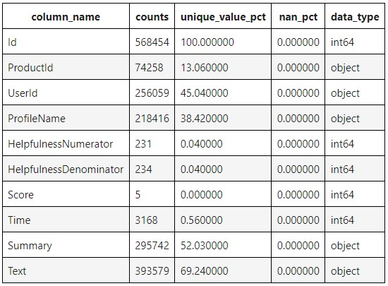
Dataset 1 Reviews.csv
568,454 data samples
10 variables (5 num, 5 cat)

Slide 5
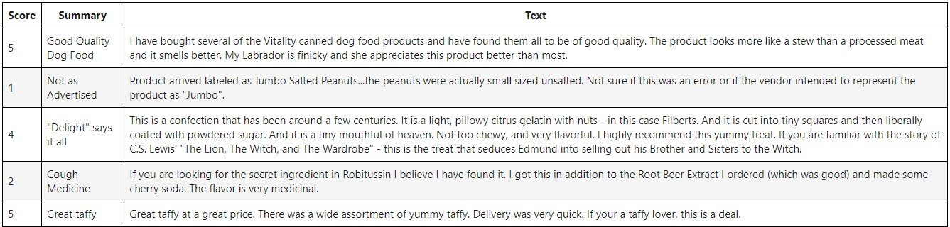
Reviews.csv – Selected Columns(head5)

Slide 6
Data Processing
Steps | Action | Variable Names | Detail Explanation | Dataset Name
Step 1 | Downsample the data to 500 sample | All variables | Drow a random sample of rows (Sample size = 500) | data from ‘Reviews.csv’
Step 2 | New Variable Creation | Summary, Text, review_text | Combine the summary / heading and text description | sample_data
Step 3 | Drop variable | Summary, Text | Remove the original columns | sample_data
Step 4 | Reset Index | All variables | Reset the Dataframe Index and drop the old index | sample_data

Slide 7
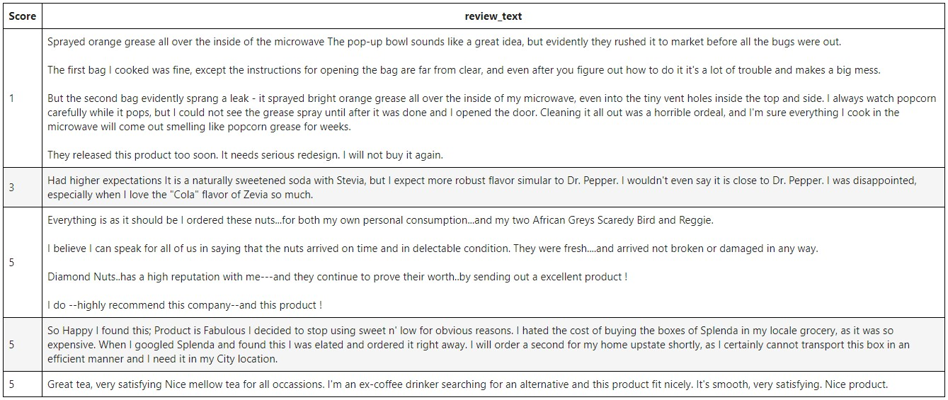
Sample Data from Reviews.csv - Sample(500, head5)
Notes:
So the dataset contains 18,359 observations of 14 variables, and 10 of them are categorical variables, 4 of them are categorical variables. And after exploring the variables I realized I can group them into 6 groups:

Slide 8

Key Findings
Notes:
In this section we will introduce the key findings we had after exploring the relationship between the predictors and our response variables

Slide 9
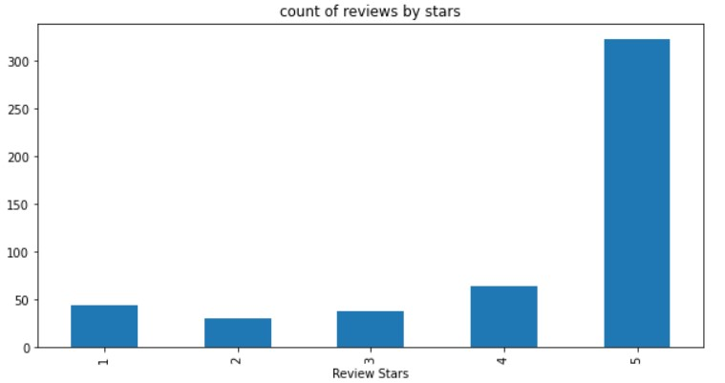
The overall distribution of reviews seems to be more positive, then there is a slight spike in the 1 star negative reviews, meaning the data is mostly very polar.
Count of reviews by stars

Slide 10
Great Price, Not what I was hoping for though. There's the original Tang. There's the fruition Tang that was around from 2008 to 2010, which had extra vitamins (B,D,A, etc.) and replaced half the sugar with zero calorie sweeteners. But tang has gone back to a flavor more similar to the original with full sugar content. I was hoping for the fruition version, which other reviewers received.
['Great', 'Price', ',', 'Not', 'what', 'I', 'was', 'hoping']
Use the NLTK’s word tokenizer to smartly split the sentence into tokens which can be used to understand the language by a computer
Basic NLTK (word_tokenize) – On the 51th row of the sample reviews

Slide 11
Great Price, Not what I was hoping for though. There's the original Tang. There's the fruition Tang that was around from 2008 to 2010, which had extra vitamins (B,D,A, etc.) and replaced half the sugar with zero calorie sweeteners. But tang has gone back to a flavor more similar to the original with full sugar content. I was hoping for the fruition version, which other reviewers received.
[('Great', 'NNP'),
('Price', 'NNP'),
(',', ','),
('Not', 'RB'),
('what', 'WP'),
('I', 'PRP'),
('was', 'VBD'),
('hoping', 'VBG'),
('for', 'IN'),
('though', 'IN')]
Find a part of the speech for each of the token words with NLTK. Each word will get a part of the speech value associated with it
and it is represented by codes like NN for singular nouns
Basic NLTK (pos_tag) – On the 51th row of the sample reviews

Slide 12
Modeling & Analysis
Notes:
In this section we will introduce the key findings we had after exploring the relationship between the predictors and our response variables

Slide 13
VADER: Valence Aware Dictionary and Sentiment Reasoner
We are starting by using the NLTK's SentimentIntensityAnalyzer to get the negative (neg), neutral (neu) and positive (pos) scores for the text.
Approach:
Uses a "bag of words" approach
Stop words are removed - words like (is, the, am, etc.)
Each word is scored and combined to a total score to get the overall sentiment score of the text.
Limitations:
Does not account for relationships between words, which is an important part of human speech.
Basic NLTK – VADER Sentiment Scoring

Slide 14
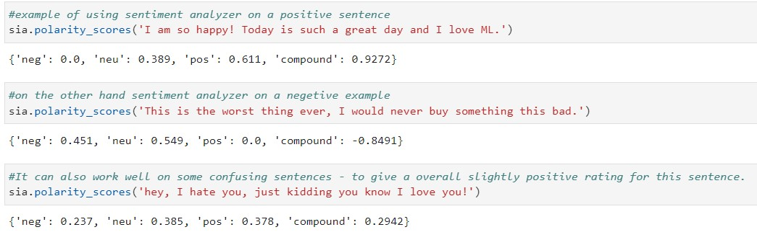
# Initializing a Sentiment Analyzer Model
Sia = SentimentIntensityAnalyzer()
BASIC NLTK – Examples of using sentiment analyzer on sentences

Slide 15
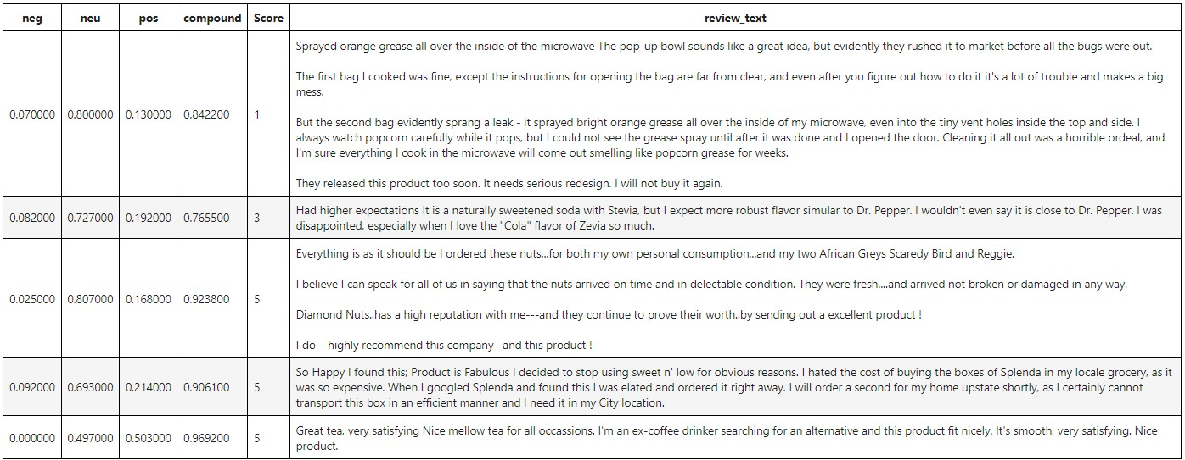
Observations:
We are successfully able to identify the overall sentiment of the text with compound score which varies between 1 (for positive) and -1 (for negative).
Now we can try to apply this to our reviews dataset.
BASIC NLTK – Results of using sentiment analyzer on the sentences in the reviews.

Slide 16
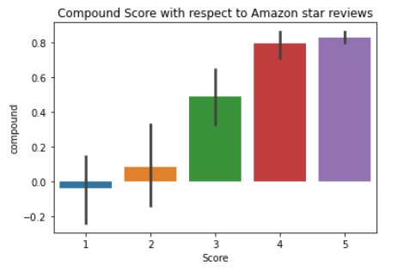
One way to see if our model is working as expected, is to check an assumption.
We can assume that the reviews our model classifies as more positive has higher star review and the ones predicted to be more negative have a lower star review associated with them.
If this is true then, we can rely on text sentiment analysis to indicate how our users feel about products overall.
Observation: The assumption seems to be right because higher star reviews have a high compound score associated with them.
BASIC NLTK – How to measure effectiveness?

Slide 17
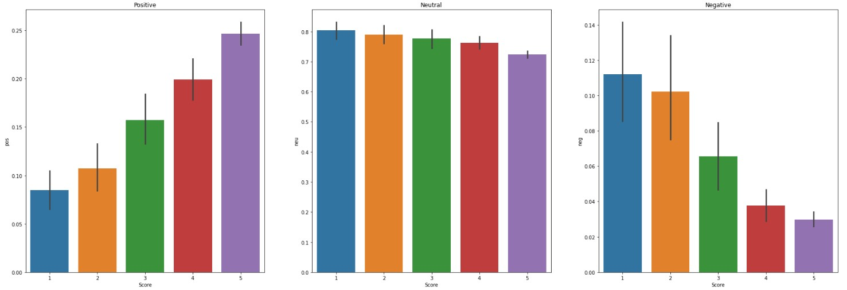
Taking a look at each component of sentiment analysis (pos, neu and neg) with respect to the star reviews
BASIC NLTK – Components of Sentiment Analysis vs star reviews

Slide 18
Observations:
Positive score is higher as star reviews are higher
Neutral score do not vary much across different star reviews
Negative score decreases with lower star reviews
We can conclude that our sentiment analysis score is related to the star reviews given by the users
Limitations:
This way of analyzing text with VADER does not consider the relationship between the words and the context in which they are used. We can improve upon that by using the state of the art Transformer based BERT model which can understand and learn context and make better predictions on overall sentiment.
Basic NLTK – VADER Sentiment Scoring observations and limitations

Slide 19
Now let’s try the RoBERTa model trained on large samples of data (with hundred Millions+ examples)
This Transformer model accounts for the words but also their context related to the other words in the text
For instance, sentences with negative words in it but actually just sarcastic.
Or ironic sentences with positive words but overall negative sentiment.
We are essentially using transfer learning by using pretrained weights of a model created for analyzing the sentiments of tweets to perform reviews of sentiment analysis.
RoBERTa Pretrained Model

Slide 20
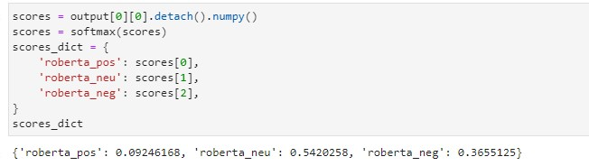
Comparing RoBERTa and VADER Performances on our example

Slide 21
Observation:
The RoBERTa Model seems to better understand the context, and give a more appropriate score for the given example. The user starts with a positive comment but actually have some complaints about the products. We can confirm from user's given rating that the overall sentiment and review is still positive.
Comparing RoBERTa and VADER Performance on our example

Slide 22
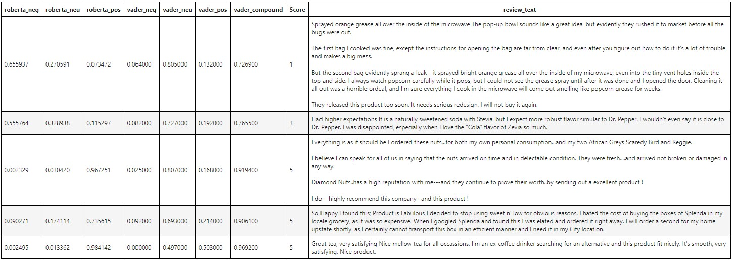
Run RoBERTa model over all the review examples

Slide 23
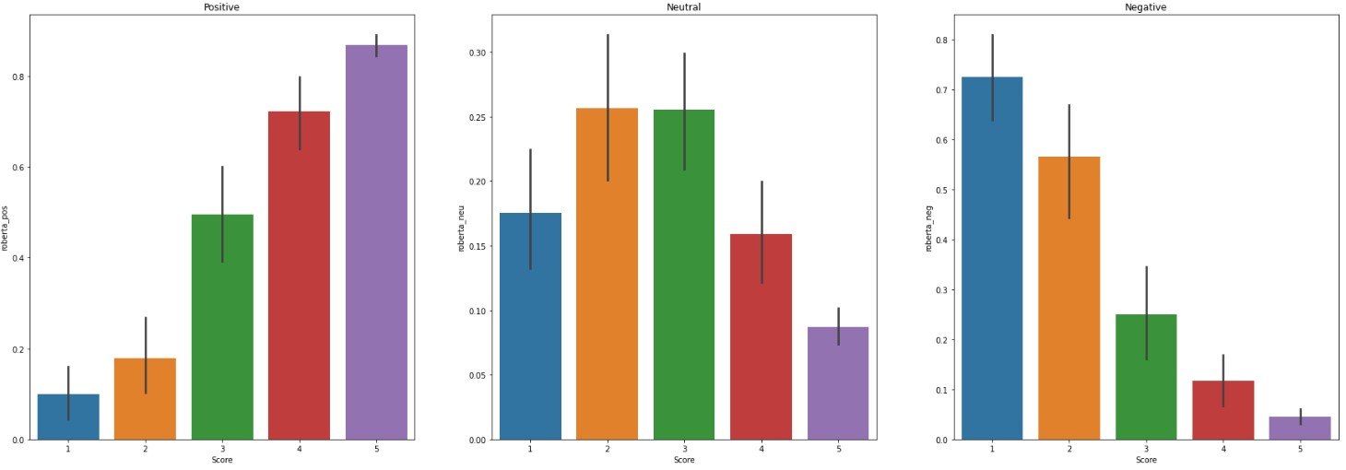
Observation:
With the roBERTa model the trend seems to be even more precise. When positive score increases the star rating increases and with lower star reviews negative sentiment decreases drastically. Thus, we can get a better idea of how the users are feeling with text sentiment predictions using the RoBERTa Model.
Plot of RoBERTa model results over all the review examples

Slide 24
Which are the examples that our models classifies as having a positive sentiment but it actually has a low star rating?
We can see this is a confusing statement as the user praises Amazon's service but is actually disappointed by the product, and our VADER model was not able to make that distinction.
RoBERTa model also got the same review wrong
Review Examples: Positive Sentiment Prediction but low star review

Slide 25
Which are the examples that our models classifies as having a negative sentiment but it actually has a high star rating?
The sentence does contain words like disappointment and user does want some changes in product but overall, the user has a positive sentiment towards the product.
In the text review, the user expresses disagreement with change in product price, so our model classified it as a negative sentiment but the user's overall sentiment towards the product is positive.
Review Examples: Negative Sentiment Prediction but high star review

Slide 26
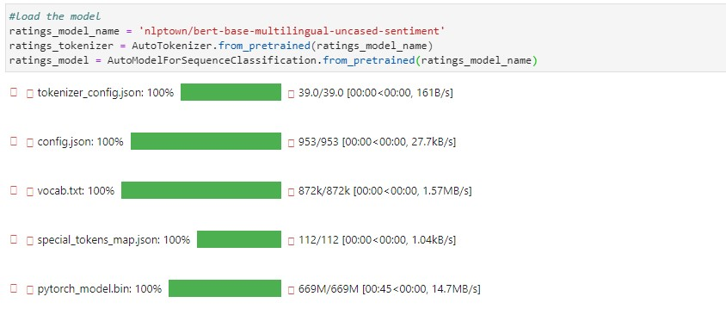
Finally, let’s use the **BERT** based model from hugging face 🤗 to classify the text between 1 to 5 star rating depending on the sentiment of the comment.
Instead of just predicting if the review is positive or not, we can get a more quantitative result in form of a rating.
BERT Model: Directly predicting the star rating from the text review

Slide 27
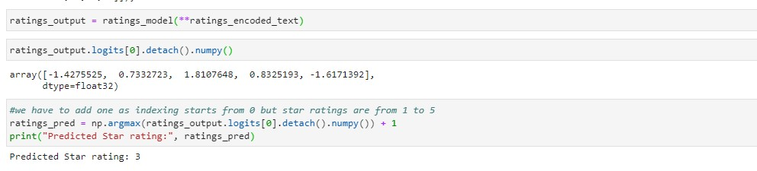
Actual Star Rating is: 4.
Predicted Star rating is: 3
BERT Model: Directly predicting the star rating from the example

Slide 28
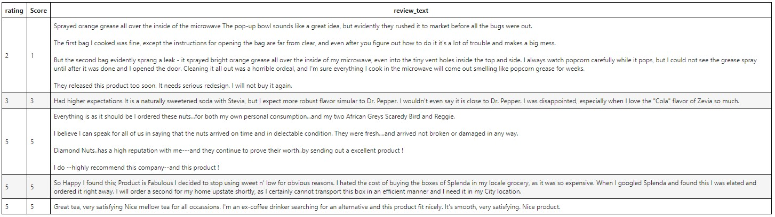
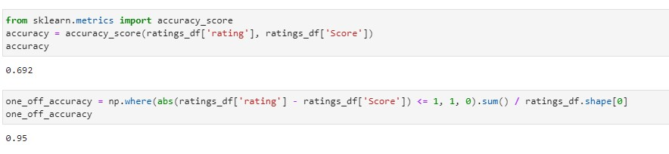
We can exactly predict the rating of review with ~70% accuracy and can predict the rating very closely (just one more or less) with 95% accuracy.
We can now say the model works considerably well and can be used to understand the users sentiments over new products and services in the future or we can use it to analyze some other existing products or businesses.
BERT Model: Make prediction for all reviews

Slide 29
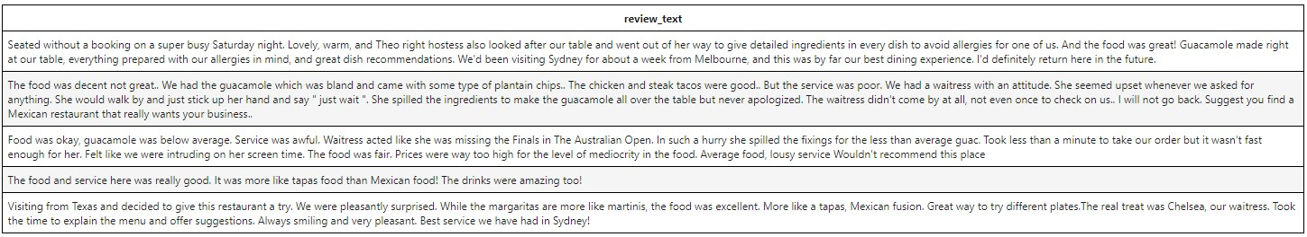
We have selected a restaurant business on Yelp and collected some reviews from the customers to see if this is a place where people like to eat or NOT. We could do a similar test for any business and collect data from multiple sources like twitter, reddit, YouTube, Facebook, Instagram and more.
BERT Model: Using Model to make predictions on new data scraped from Yelp to perform Sentiment Analysis

Slide 30
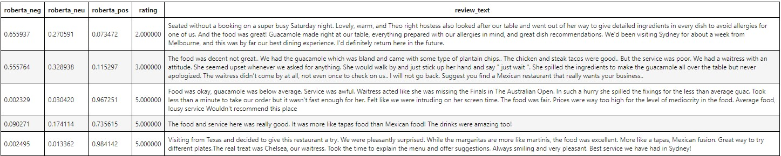

We can perform a sentiment analysis over these text reviews
Using RoBERTa model to get different component scores (pos, neu and neg) and BERT to predict numerical star ratings
BERT Model: Yelp Data prediction results

Slide 31
VADER
Does not account for relationships between words, which is an important part of human speech.
RoBERTa
The RoBERTta Model does seem to better understand the context and give an overall more appropriate score for the given example.
BERT
We can exactly predict the rating of review with ~70% accuracy and can predict the rating very closely (just one more or less) with 95% accuracy.
VADER
SentimentIntensityAnalyzer to get the negative (neg), neutral (neu) and positive (pos) scores for the text
RoBERTa
RoBERTa Transformer model accounts for the words but also their context related to other words
BERT
BERT based model directly classify the text between 1 to 5 star rating depending on the sentiment of the comment.
Model evaluation
VADER, RoBERTa and BERT Models Evaluation

Slide 32
Conclusion
Notes:
In this section we will introduce the key findings we had after exploring the relationship between the predictors and our response variables

Slide 33
Conclusion
Using text reviews we predicted that the restaurant has an overall rating of approximately 4, and we confirm that our model can give us a good idea about sentiment towards any business with just text reviews because the actual rating of the restaurant is 4.5 and we were able to closely predict that with just a small sample of reviews. We could improve our prediction by analyzing all the reviews.
How is all of this useful?
We can use hundreds of thousands of online comments and text reviews posted by people on social media about any particular product, movie, service, business or Ad campaign to understand the overall feeling of public towards that. We can use this approach to better select and market our products and make data driven decisions. My recommendation will be to use the RoBERTa model to better understand the context and obtain an appropriate score, then use the BERT model to predict the rating of reviews with high accuracy .
This can help us deliver better services and increase profit margins among other things.
Conclusion and Recommendation

Slide 34
Appendix
Notes:
In this section we will introduce the key findings we had after exploring the relationship between the predictors and our response variables

Slide 35
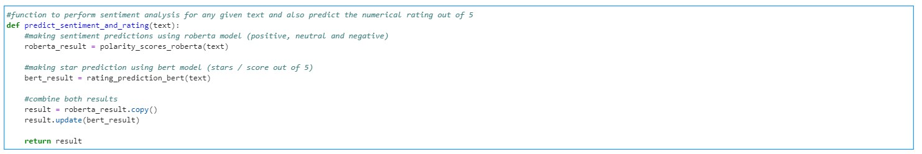
Function for making predictions

Slide 36
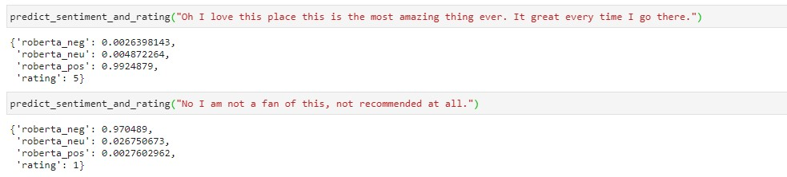
We can use this function in the future to make predictions on any review to analyze the sentiment of the user and learn their opinion quantitatively
This function can also be used to deploy a simple web app that works for a single review at a time or a batch of multiple reviews.
Predictions Examples using our Custom Predictions Function

